Slide 1
Third Party Marketing Organization Materials Submission & Review MAC Virtual Selling Event
April 2024

Slide 2
Compliance with CMS Guidelines
CMS marketing requirements All marketing materials must be compliant with Medicare Advantage (MA) and Part D Communications and Marketing
(42 CFR parts 422 and 423, subpart V)
Insurers offering MAPD plans are required to ensure compliance by Third Party Marketing Organizations* (TPMOs) through an oversight plan that monitors agent/broker activities
Broker Agents are part of the oversight plan, as we are counting on them to submit their items to us, the insurers.
Regulations specific to TPMOs:
Disclaimers:
List or mention all the MA organization or Part D sponsors that the TPMO represents on marketing materials
Include SHIPs as an option for beneficiaries to obtain additional help on the TPMO disclaimer
State the number of organizations represented by the TPMO as well as the number of plans on the TPMO disclaimer
Record calls between TPMOs and beneficiaries, including virtual connections such as video conferencing and other virtual telepresence methods - for example, a meeting on Zoom
* Third party marketing organizations (TPMOs): all organizations and individuals, including independent agents and brokers, who are compensated to perform lead generation, marketing, sales, and enrollment related functions as a part of the chain of enrollment

Slide 3
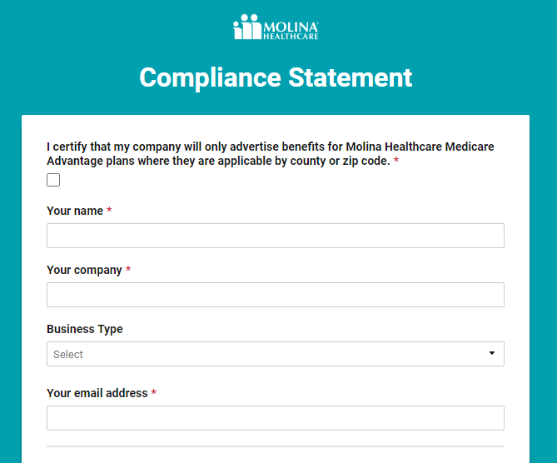
Before You Use the System One Time Step
Sign compliance statement
Check the box and add contact information

Slide 4
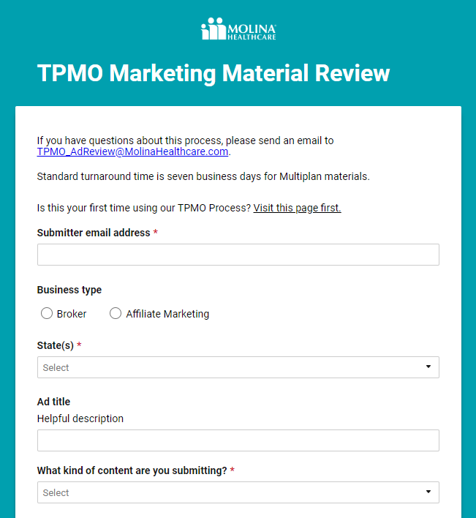
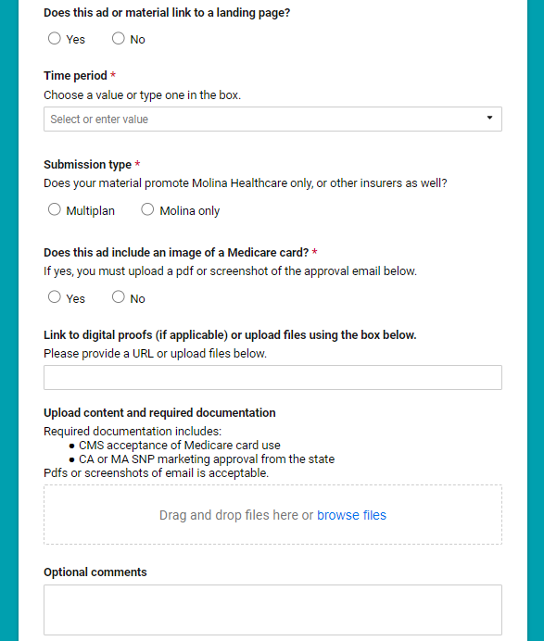
Step One – Intake Form Submission
TPMO company uses form to submit material
Intake Form: Click here to open form
Website: MolinaMarketingReview.com

Slide 5
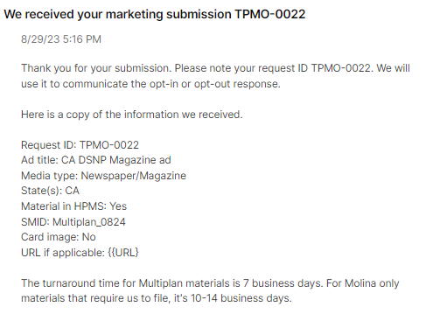
Notification for review is sent
The TPMO receives an auto generated response/copy of the information submitted and request ID.
The process takes 7 business days for Multiplan ads and 10-14 business days for Molina only ads.

Slide 6
Required Information
The ad and knowledge of states where it will be shown
Link to digital proof
Common file formats uploaded as attachments (Word, Pdf, Jpeg, etc...)
Submission type (how it will be used)
Multiplan:
If the material promotes multiple insurers, it is a Multiplan filing; select Multiplan in the drop down.
The TPMO must give Molina an SMID code (Standardized Material Identification code.)
Molina only:
If the material only promotes Molina product offerings, choose Molina only from the drop down
Molina will file the material in HPMS
The TPMO will receive an email when the SMID is available
Link to ad landing page
Landing pages need the right disclaimers
Medicare card images
CMS requires all ads using card images to get email approval; attach the approval email as a pdf or screenshot and upload it with the ad (see sample on next slide)

Slide 7
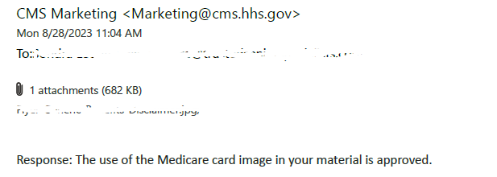
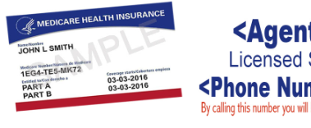
Examples of Good Submissions
CMS Approval for use of Medicare Care Image
Landing page containing the right disclaimers is provided along with a digital ad

Slide 8
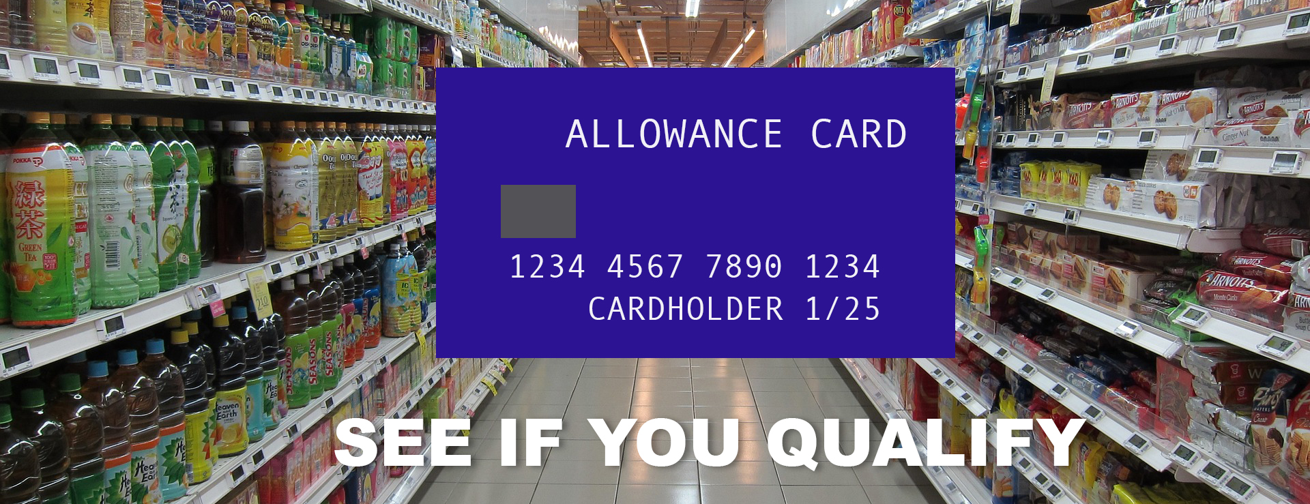
Examples of Problem Submissions
- Debit cards should NOT be referred to as allowance cards
- Grocery benefit advertising requires a special SSBCI disclaimer in the same font size as the contact information, or read at the same pace ad advertised phone number
Special Supplemental Benefits ("SSBCI") might be available to you if you have any of the following conditions: [chronic heart failure, cardiovascular disorders, diabetes, cancer and end-stage liver disease]. Other eligible conditions not listed. These conditions may not apply to all types of SSBCI mentioned. Eligibility for this benefit cannot be guaranteed based solely on your condition. All applicable eligibility requirements must be met before the benefit is provided. For details, please contact us.

Slide 9
Step Two: First Review
The first round of review is completed by the marketing team
All submissions are reviewed for disclaimers:
3rd Party Marketing Disclaimer
Benefits disclaimer
Events – Giveaways
Events – Accommodation Disclaimer
SSBCI – needed for promoting benefits only available to the Chronically Ill
Federal contracting statement
Molina only material is reviewed for:
Molina logo used correctly
Brand name used correctly
* For guidance: Brand Central
* For guidance: 2025 Disclaimers

Slide 10
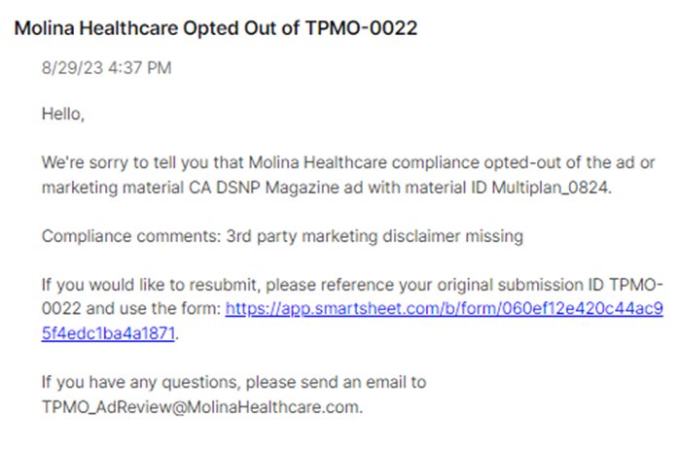
Step Two: First Review
Meets Guidelines | Does Not Meet Guidelines
Molina’s compliance department is prompted to make the final review | Does not meet guidelines is selected if the content is problematic for a known reason Marketing will choose Opt out A brief compliance comment is sent to you Information on how to resubmit is provided

Slide 11
Step Three: Compliance Review
The second round of review is completed by the compliance team
In addition to reviewing the disclaimers again, the team checks for:
Anything that might be misleading to beneficiaries
Accurate benefits for service areas
CMS approval of Medicare card images attached as a screenshot or pdf
Vague benefit statements like “up to $” or “as low as” (not allowed)
Misleading graphics such as an “allowance card” or graphic design style that mimics a government communication
Unsubscribe options for email and text messages

Slide 12
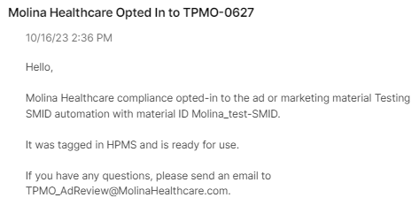
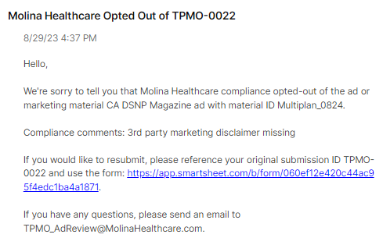
Step Four: Opt-In/Out Notification
Opt-In Email | Opt-Out Email
You will receive a notification that we located the material in HPMS and opted in | The submitter is notified, via email, with the reason See appendix for common Opt-Out reasons.

Slide 13
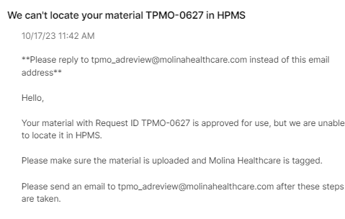
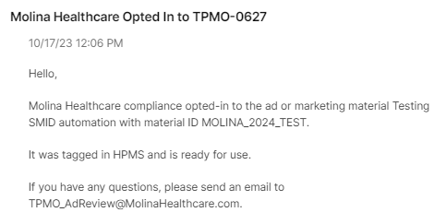
Locating Material in HPMS
Multiplan materials: After final approval, Molina will look for your material in HPMS (if it’s a Multiplan submission) to complete the process
Not Found | Found
If your material can’t be located with SMID from our account in HPMS, you will be notified with the email below | When material is found in HPMS, the Opt in or Opt out will be noted for CMS; you will be notified that the ad is ready for use
Molina only materials: our OML team will submit the material — you will be notified when the SMID code is available, and it was accepted by CMS (see slide 5)

Slide 14
Sum it Up
Fill Out the Submission Form
First Review: Marketing
Second Review: Compliance
HPMS Opt in/out Tag
Ready for Use

Slide 15
Appendix: Common Reasons for Opt-outs
Back
Third party marketing disclaimer:
We’re seeing variations of this statement that don’t meet the guidelines.
We do not offer every plan available in your area. Currently we represent [insert number of organizations] organizations which offer [insert number of plans] products in your area. Please contact Medicare.gov, 1–800–MEDICARE, or your local State Health Insurance Program to get information on all of your options.
Grocery and other SSBCI benefits:
CMS commented in the final rule specifically about these ads being misleading.
Required Format: Pace (if audible) and font (if written) of disclaimer must be same as contact information provided. For television, online, social media, radio, or other voice-based adds, must use same font and read at the same pace as the advertised phone number or other contact information. The same font rule applies to outdoor advertising.
Special Supplemental Benefits ("SSBCI") might be available to you if you have any of the following conditions: [chronic heart failure, cardiovascular disorders, diabetes, cancer and end-stage liver disease]. Other eligible conditions not listed. These conditions may not apply to all types of SSBCI mentioned. Eligibility for this benefit cannot be guaranteed based solely on your condition. All applicable eligibility requirements must be met before the benefit is provided. For details, please contact us.

